Slide 1


Network Scanning and Friends
... But Mostly Just Wireshark
Luis Baez CyberSecurity Club Meeting Monday Sept 23rd @ 7 PM Swearingen 2A14

Slide 2
Disclaimer
This is just a scanning talk. Do not scan the Government, the Army, the Navy, the anything that's not yours or legal to scan. Some applications in this talk can be used in a black hat manner. WE DO NOT ENCOURAGE THAT. This purpose of talks like these are to make you aware of what attackers can do and to be able to check yourself. Once again, If you don’t know if it’s legal, either look it up, ask someone, or just don’t do it.

Slide 3
Net..What?
A network - Collection of technology( Computers, phones, printers, servers, toasters, whatever) that are connected to each other and able to share information. Ex: The Internet

Slide 4
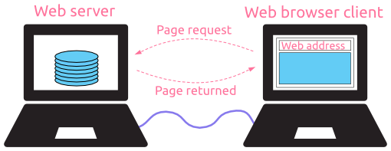
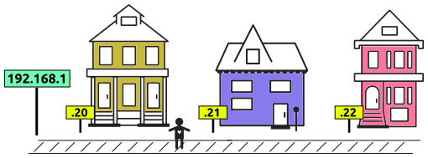
Networking 101
LAN - local area network WAN - Wide area network VPN - virtual private network ifconfig - gets my IP IP = Internet Protocol Address 1 to 254, EX: 172.129.10.1 or 5.99.130.40

Slide 5
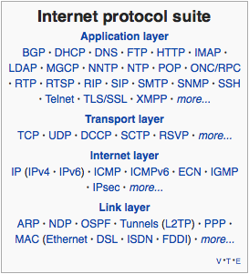
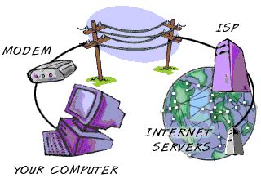
More basics
HTTP- hyper text transfer protocol TCP- transmission control protocol UDP- user datagram protocol FTP or SFTP-File transfer protocol DNS - domain name system
CSCE 416 in a nutshell

Slide 6
Tools
Scanning for gold?
Scanning NMAP Snort Wireshark TCPdump Utilizing Aircrack Airsnort Airjack Metasploit

Slide 7
*insert sexy shark pic on this slide*

Slide 8

Wireshark
https://www.wireshark.org/ Do a Demo...

Slide 9

NMAP
https://nmap.org/
nmap [ <Scan Type> ...] [ <Options> ] { <target specification> } Another Demo, with this: https://nmapcookbook.blogspot.com/2010/02/nmap-cheat-sheet.html

Slide 10

TCPDUMP (If we get there)
https://www.tcpdump.org/ Maybe a demo: https://www.andreafortuna.org/2018/07/18/tcpdump-a-simple-cheatsheet/

Slide 11
Questions?
Questions?Questions?Questions?Questions?Questions?Questions?Questions?Questions?Questions?Questions?Questions?Questions?Questions?Questions?Questions?Questions?Questions?Questions?

